Slide 1


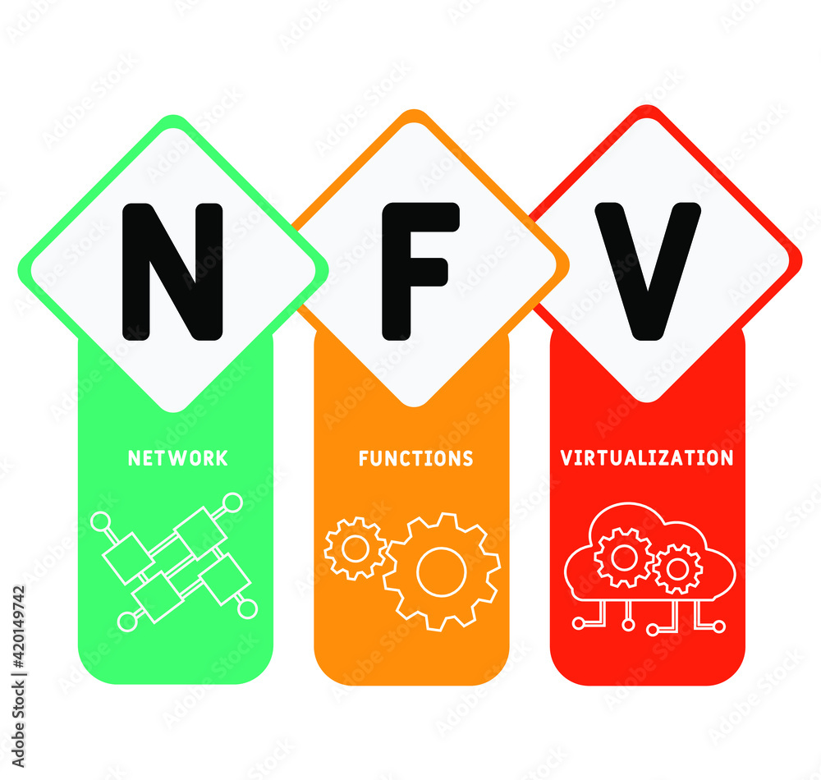

PDS
Computer Vision
Chapter 5:
Deep Learning
https://github.com/siagianp
https://github.com/amelcharolinesgn2/IoT_simulator-mqtt-NodeRed
https://www.youtube.com/@AmelOline/videos
Notes:
https://medium.com/buildpiper/simplifying-containerization-with-docker-run-command-2f74e114f42a
https://github.com/IBA-Group-IT/IoT-data-simulator
https://www.bevywise.com/blog/docker-mqtt-broker-easy-service-manageability/

Slide 2
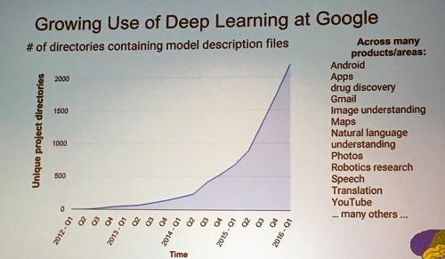
Deep learning attracts lots of attention.
I believe you have seen lots of exciting results before.
Deep learning trends at Google. Source: SIGMOD 2016/Jeff Dean
Notes:
Google DeepMind團隊將以機器學習技術分析匿名的視網膜掃瞄圖像資料
蔡明介：台灣想搞AI 再加2個零

Slide 3
Ups and downs of Deep Learning
1958: Perceptron (linear model)
1969: Perceptron has limitation
1980s: Multi-layer perceptron
Do not have significant difference from DNN today
1986: Backpropagation
Usually more than 3 hidden layers is not helpful
1989: 1 hidden layer is “good enough”, why deep?
2006: RBM initialization
2009: GPU
2011: Start to be popular in speech recognition
2012: win ILSVRC image competition
2015.2: Image recognition surpassing human-level performance
2016.3: Alpha GO beats Lee Sedol
2016.10: Speech recognition system as good as humans
Notes:
They were popularised by Frank Rosenblatt in the early 1960’s.
In 1969, MIT ＭArvin Minsky and Papert published a book called “Perceptrons” that analysed what they could do and showed their limitations.
The backpropagation algorithm was originally introduced in the 1970s, but its importance wasn't fully appreciated until a famous 1986 paper by David Rumelhart, Geoffrey Hinton, and Ronald Williams.
During the 1950s and ’60s, neural networks were in vogue among computer scientists. In 1958, Cornell research psychologist Frank Rosenblatt, in a Navy-backed project, built a prototype neural net, which he called the Perceptron, at a lab in Buffalo. It used a punch-card computer that filled an entire room. After 50 trials it learned to distinguish between cards marked on the left and cards marked on the right. Reporting on the event, the New York Times wrote, “The Navy revealed the embryo of an electronic computer today that it expects will be able to walk, talk, see, write, reproduce itself and be conscious of its existence.”
One of the first versions of the theorem was proved by George Cybenko in 1989 for sigmoid activation functions
1989: http://deeplearning.cs.cmu.edu/notes/Sonia_Hornik.pdf
George Cybenko is the Dorothy and Walter Gramm Professor of Engineering at Dartmouth and a fellow of the IEEE
Speech: begin 2009
2012: Times

Slide 4
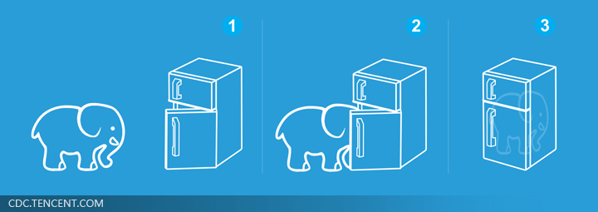
Three Steps for Deep Learning
Step 1: define a set of function
Step 2: goodness of function
Step 3: pick the best function
Neural
Network
Deep Learning is so simple ……
Notes:
http://www.twword.com/wiki/%E8%85%A6%E6%88%B6%E7%A9%B4
http://ukenglish.pixnet.net/blog/post/105691160-%E3%80%90%E5%8F%B0%E5%8D%97%E5%B8%82%E5%AD%B8%E8%8B%B1%E8%AA%9E%EF%BC%8C%E5%84%AA%E9%85%B7%E8%8B%B1%E8%AA%9E%E6%96%87%E7%90%86%E5%85%AC%E5%91%8A%E3%80%91%E6%9C%AC%E4%B8%AD%E5%BF%83
http://onepiece1234567890.blogspot.tw/2013/12/blog-post_8.html

Slide 5
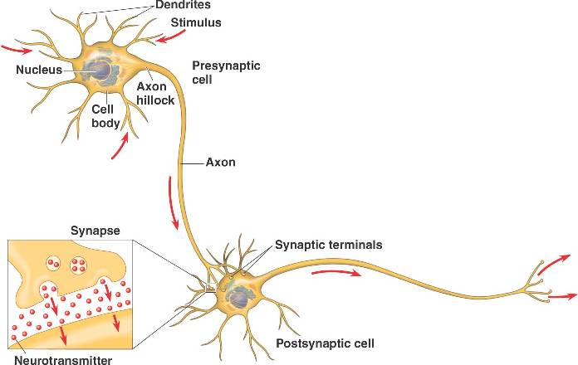
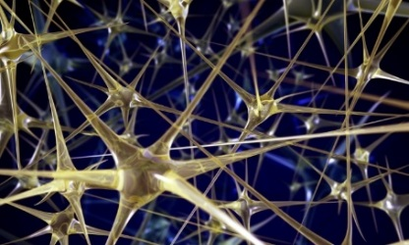
Neural Network
“Neuron”
Neural Network
Different connection leads to different network structures
Network parameter $θ$: all the weights and biases in the “neurons”
Notes:
瞬間潮了起來

Slide 6
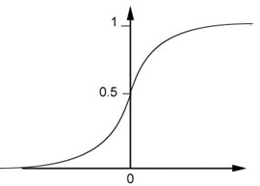
Fully Connect Feedforward Network
1
4
0.98
1
-2
1
-1
-2
0.12
-1
1
0
Sigmoid Function
Notes:
Ignore +

Slide 7
Fully Connect Feedforward Network
1
4
0.98
2
0.86
3
0.62
1
-2
-1
-1
1
0
-2
-1
-2
0.12
-2
0.11
-1
0.83
-1
1
-1
4
0
0
2

Slide 8
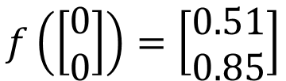
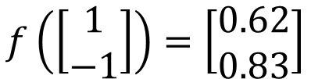
Fully Connect Feedforward Network
1
0.73
2
0.72
3
0.51
0
-2
-1
-1
1
0
-2
-1
0.5
-2
0.12
-1
0.85
0
1
-1
4
0
0
2
This is a function.
$$f\left(\left[\begin{matrix}1 \\ −1\end{matrix}\right]\right)=\left[\begin{matrix}0.62 \\ 0.83\end{matrix}\right]$$
$$f\left(\left[\begin{matrix}0 \\ 0\end{matrix}\right]\right)=\left[\begin{matrix}0.51 \\ 0.85\end{matrix}\right]$$
Input vector, output vector
Given network structure, define a function set
Notes:
For example, if we modify “1” to “2”, then we have another function

Slide 9
Fully Connect Feedforward Network
neuron
Input
Layer 1
Layer 2
Layer L
Output
……
y₁
……
y₂
……
……
……
……
……
……
y_{M}
Input Layer
Output Layer
Hidden Layers
Notes:
You can connect the neurons by other ways you like ☺
How many layer is deep?
CNN just another way to connect the neuros.
You can always connect the neurons in your own way.
“+” is ignored
Each dimension corresponds to a digit (10 dimension is needed)

Slide 10
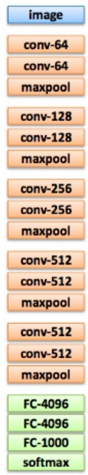
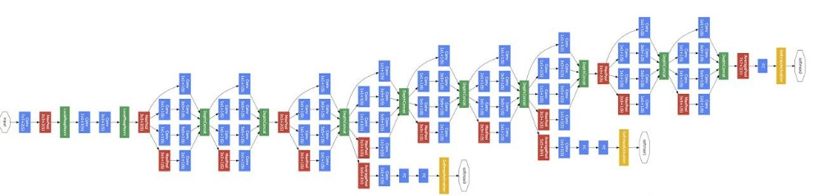
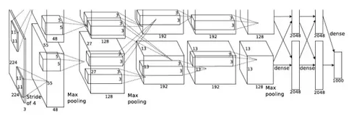
Deep = Many hidden layers
22 layers
http://cs231n.stanford.edu/slides/winter1516_lecture8.pdf
19 layers
8 layers
6.7%
7.3%
16.4%
AlexNet (2012)
VGG (2014)
GoogleNet (2014)

Slide 11

Deep = Many hidden layers
152 layers
101 layers
Special
structure
Ref: https://www.youtube.com/watch?v=dxB6299gpvI
3.57%
7.3%
6.7%
16.4%
AlexNet (2012)
VGG
(2014)
GoogleNet
(2014)
Residual Net
(2015)
Taipei
101
Notes:
169層

Slide 12
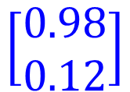

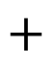
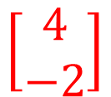
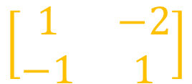
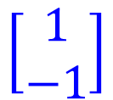

Matrix Operation
1
4
0.98
1
-2
1
-1
-2
0.12
-1
1
0
$$\left[\begin{matrix}1 & −2 \\ −1 & 1\end{matrix}\right]$$
$$\left[\begin{matrix}1 \\ −1\end{matrix}\right]$$
$$\left[\begin{matrix}1 \\ 0\end{matrix}\right]$$
$$=$$
$$\left[\begin{matrix}0.98 \\ 0.12\end{matrix}\right]$$
$$σ\left( \right)$$
$$+$$
$$\left[\begin{matrix}4 \\ −2\end{matrix}\right]$$
Notes:
Make sure you know how to do it
author: Adam Coates, Baidu, Inc.
Deep Learning (hopefully faster)
http://videolectures.net/deeplearning2015_coates_deep_learning/

Slide 13
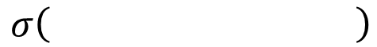
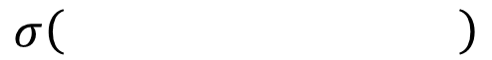
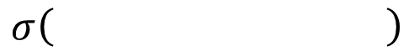
Neural Network
……
y₁
W¹
W²
W^{L}
……
y₂
b¹
b²
b^{L}
……
……
……
……
……
x
a¹
a²
y
……
y_{M}
W¹
x
b¹
+
$$σ\left( \right)$$
a¹
b²
W²
+
$$σ\left( \right)$$
W^{L}
b^{L}
a^{L-1}
+
$$σ\left( \right)$$
Notes:
Draw it?

Slide 14
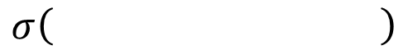
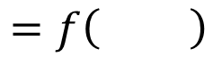
Neural Network
……
y₁
W¹
W²
W^{L}
……
y₂
b¹
b²
b^{L}
……
……
……
……
……
x
a¹
a²
y
……
y_{M}
y
x
Using parallel computing techniques to speed up matrix operation
$$=f\left( \right)$$
W^{L}
…
W²
W¹
x
b¹
b²
…
b^{L}
+
+
+
$$σ\left( \right)$$
$$=σ\left( \right)$$
$$σ\left( \right)$$
Notes:
Draw it?

Slide 15
Output Layer as Multi-Class Classifier
Feature extractor replacing feature engineering
……
y₁
……
y₂
Softmax
……
……
……
……
……
……
y_{M}
Input Layer
Output Layer
= Multi-class Classifier
Hidden Layers

Slide 16
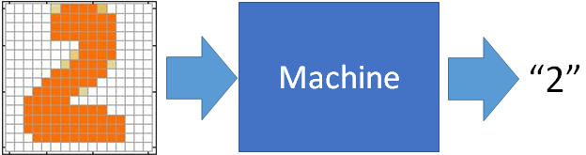
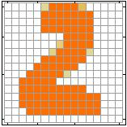
Example Application
Input
Output
y₁
is 1
0.1
y₂
is 2
0.7
The image is “2”
……
……
……
y₁₀
0.2
is 0
16 x 16 = 256
Ink → 1
No ink → 0
Each dimension represents the confidence of a digit.
Notes:
The same for even more complex tasks.

Slide 17
Example Application
Handwriting Digit Recognition
y₁
is 1
Machine
y₂
is 2
Neural
Network
“2”
……
……
……
y₁₀
is 0
What is needed is a function ……
Input:
256-dim vector
output:
10-dim vector
Notes:
The same approach for other cases

Slide 18
Example Application
Input
Layer 1
Layer 2
Layer L
Output
……
y₁
is 1
……
A function set containing the candidates for
Handwriting Digit Recognition
y₂
is 2
“2”
……
……
……
……
……
……
……
y₁₀
is 0
Input Layer
Output Layer
Hidden Layers
You need to decide the network structure to let a good function in your function set.
Notes:
CNN just another way to connect the neuros.
You can always connect the neurons in your own way.
“+” is ignored
Each dimension corresponds to a digit (10 dimension is needed)

Slide 19
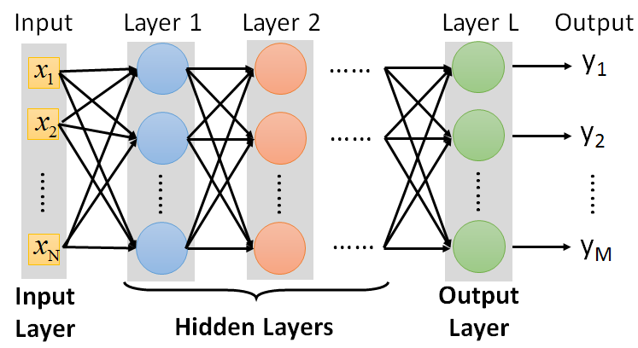
FAQ
Q: How many layers? How many neurons for each layer?
Q: Can the structure be automatically determined?
E.g. Evolutionary Artificial Neural Networks
Q: Can we design the network structure?
Trial and Error
+
Intuition
Convolutional Neural Network (CNN)

Slide 20
Three Steps for Deep Learning
Step 1: define a set of function
Step 2: goodness of function
Step 3: pick the best function
Neural
Network
Deep Learning is so simple ……
Notes:
http://www.twword.com/wiki/%E8%85%A6%E6%88%B6%E7%A9%B4
http://ukenglish.pixnet.net/blog/post/105691160-%E3%80%90%E5%8F%B0%E5%8D%97%E5%B8%82%E5%AD%B8%E8%8B%B1%E8%AA%9E%EF%BC%8C%E5%84%AA%E9%85%B7%E8%8B%B1%E8%AA%9E%E6%96%87%E7%90%86%E5%85%AC%E5%91%8A%E3%80%91%E6%9C%AC%E4%B8%AD%E5%BF%83
http://onepiece1234567890.blogspot.tw/2013/12/blog-post_8.html

Slide 21

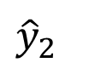
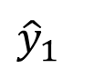
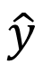
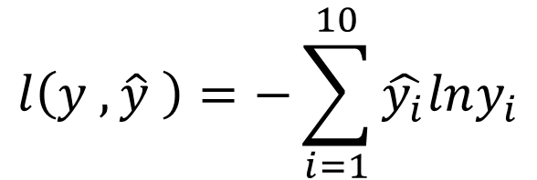
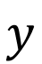
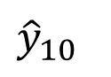
Loss for an Example
target
“1”
……
y₁
$${\hat{y}}_{1}$$
1
……
0
Given a set of parameters
y₂
$${\hat{y}}_{2}$$
Softmax
……
……
……
……
Cross
Entropy
……
……
……
y₁₀
0
$${\hat{y}}_{10}$$
$$y$$
$$\hat{y}$$
$$l\left(y ,\hat{y} \right)=−\sum_{i=1}^{10}{\hat{y_{i}}lny_{i}}$$
Notes:
https://www.youtube.com/watch?v=XWTfgehRxzU
You can never tind this in the textbook!
With softmax, the summation of all the ouputs would be one.
Can be considered as probability if you want ……

Slide 22


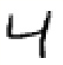
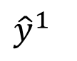
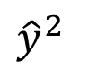
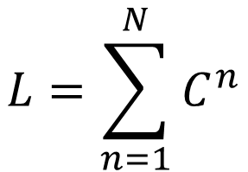
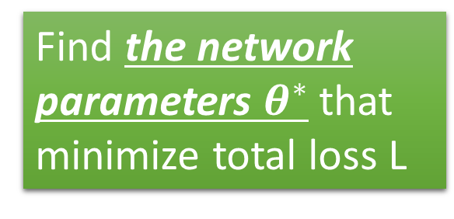
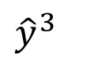
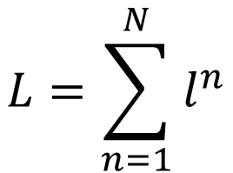
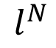
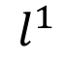
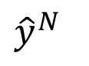
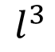
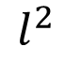
Total Loss
Total Loss:
$$L=\sum_{n=1}^{N}{l^{n}}$$
For all training data …
x¹
NN
y¹
$${\hat{y}}^{1}$$
$$l^{1}$$
NN
Find a function in function set that minimizes total loss L
x²
y²
$${\hat{y}}^{2}$$
$$l^{2}$$
x³
NN
y³
$${\hat{y}}^{3}$$
$$l^{3}$$
……
……
……
……
Find the network parameters $θ^{∗}$ that minimize total loss L
x^{N}
NN
y^{N}
$${\hat{y}}^{N}$$
$$l^{N}$$
Notes:
Randomly picked one
Two approaches update the parameters towards the same direction, but stochastic is faster!
Better!

Slide 23
Three Steps for Deep Learning
Step 1: define a set of function
Step 2: goodness of function
Step 3: pick the best function
Neural
Network
Deep Learning is so simple ……
Notes:
http://www.twword.com/wiki/%E8%85%A6%E6%88%B6%E7%A9%B4
http://ukenglish.pixnet.net/blog/post/105691160-%E3%80%90%E5%8F%B0%E5%8D%97%E5%B8%82%E5%AD%B8%E8%8B%B1%E8%AA%9E%EF%BC%8C%E5%84%AA%E9%85%B7%E8%8B%B1%E8%AA%9E%E6%96%87%E7%90%86%E5%85%AC%E5%91%8A%E3%80%91%E6%9C%AC%E4%B8%AD%E5%BF%83
http://onepiece1234567890.blogspot.tw/2013/12/blog-post_8.html

Slide 24
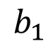
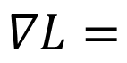
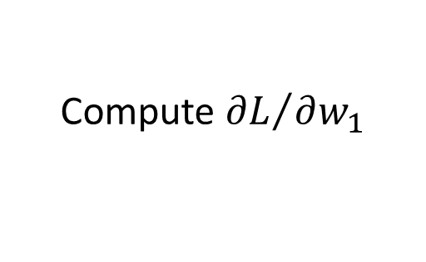
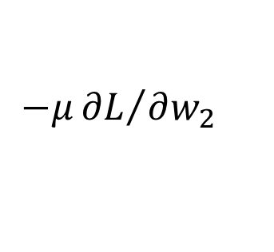
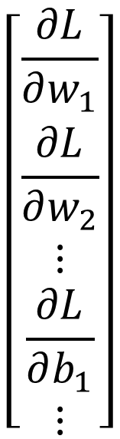
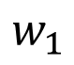
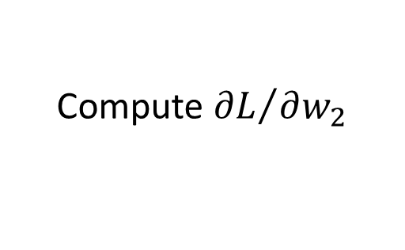
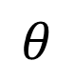




Gradient Descent
$$θ$$
Compute ${∂L}/{∂w_{1}}$
$$\left[\begin{aligned}\frac{∂L}{∂w_{1}} \\ \frac{∂L}{∂w_{2}} \\ ⋮ \\ \frac{∂L}{∂b_{1}} \\ ⋮\end{aligned}\right]$$
$$w_{1}$$
0.2
0.15
$$−μ{∂L}/{∂w_{1}}$$
Compute ${∂L}/{∂w_{2}}$
$$w_{2}$$
-0.1
0.05
$$∇L=$$
$$−μ{∂L}/{∂w_{2}}$$
……
Compute ${∂L}/{∂b_{1}}$
$$b_{1}$$
0.3
0.2
$$−μ{∂L}/{∂b_{1}}$$
……
gradient

Slide 25






Gradient Descent
$$θ$$
Compute ${∂L}/{∂w_{1}}$
Compute ${∂L}/{∂w_{1}}$
$$w_{1}$$
0.2
0.15
0.09
$$−μ{∂L}/{∂w_{1}}$$
$$−μ{∂L}/{∂w_{1}}$$
……
Compute ${∂L}/{∂w_{2}}$
Compute ${∂L}/{∂w_{2}}$
$$w_{2}$$
-0.1
0.05
0.15
$$−μ{∂L}/{∂w_{2}}$$
$$−μ{∂L}/{∂w_{2}}$$
……
……
Compute ${∂L}/{∂b_{1}}$
Compute ${∂L}/{∂b_{1}}$
$$b_{1}$$
0.3
0.2
0.10
$$−μ{∂L}/{∂b_{1}}$$
$$−μ{∂L}/{∂b_{1}}$$
……
……

Slide 26


Gradient Descent
This is the “learning” of machines in deep learning ……
Even alpha go using this approach.
People image ……
Actually …..
I hope you are not too disappointed :p
Notes:
Congugate gradient

Slide 27









Backpropagation
Backpropagation: an efficient way to compute ${∂L}/{∂w}$ in neural network
libdnn
台大周伯威
同學開發
Ref: http://speech.ee.ntu.edu.tw/~tlkagk/courses/MLDS_2015_2/Lecture/DNN%20backprop.ecm.mp4/index.html
Notes:
amazon-dsstne

Slide 28
Three Steps for Deep Learning
Step 1: define a set of function
Step 2: goodness of function
Step 3: pick the best function
Neural
Network
Deep Learning is so simple ……
Notes:
http://www.twword.com/wiki/%E8%85%A6%E6%88%B6%E7%A9%B4
http://ukenglish.pixnet.net/blog/post/105691160-%E3%80%90%E5%8F%B0%E5%8D%97%E5%B8%82%E5%AD%B8%E8%8B%B1%E8%AA%9E%EF%BC%8C%E5%84%AA%E9%85%B7%E8%8B%B1%E8%AA%9E%E6%96%87%E7%90%86%E5%85%AC%E5%91%8A%E3%80%91%E6%9C%AC%E4%B8%AD%E5%BF%83
http://onepiece1234567890.blogspot.tw/2013/12/blog-post_8.html

Slide 29




Ex:1
Why Deep learning?
There outshines deep learning where algorithms constantly increases accuracy with the increasing amount of data. ML also doesn’t perform well over high dimensional data.
Notes:
https://developer.ibm.com/articles/introduction-to-convolutional-neural-networks/

Slide 30


Slide 31

Notes:
https://brightonnkomo.medium.com/convolutional-neural-networks-part-4-the-pooling-and-fully-connected-layer-394ec01fb00d

Slide 32
CNN
The typical structure of a CNN consists of three basic layers
Convolutional layer: These layers generate a feature map by sliding a filter over the input image and recognizing patterns in images.
Pooling layers: These layers downsample the feature map to introduce Translation invariance, which reduces the overfitting of the CNN model.
Fully Connected Dense Layer: This layer contains the same number of units as the number of classes and the output activation function such as “softmax” or “sigmoid”

Slide 33


This shift in subsequent convolutions is called the stride, and hence the name strided convolutions.
If we have an image of dimension n x n with a padding p, which is convolved with filter of dimension f x f witha stride of s, then the output dimensions can be determined using the below general equation:
Strided Convolutions
When we are dealing with convolution on images of very large size, its not always required to convolve over each and every pixel of an image. So we can set the subsequent convolutions to be shifted by more than one pixel in either the vertical or horizontal axis.

Slide 34
Input image
Convolution layer
Pooling Layer (max pooling or avg pooling)
Flattening
Fully connected Layer (default neural network)

Slide 35

1. Input Image
Notes:
https://medium.com/@Yurvaj/if-you-are-looking-for-some-resource-that-could-help-you-to-understand-the-way-cnn-works-in-a-9260aa845ccb

Slide 36


2. Conv layer
how the convolution process will take place for the entire image of 5 * 5 pixels and filter size of 3 * 3 dimensions
Basically first of all we need to define the number of filters and the dimension of those filters which will convolve through image to extract features from the image .
After defining the filters and dimension of those filters the very first filter of n*n dimension will start convolving through n*n block of pixles of the image and the dot product of the 2 matrix will take place .
Notes:
https://teetracker.medium.com/an-illustration-gif-to-explain-deep-convolutional-networks-dcnn-da4cef557c9d

Slide 37



2. Conv layer

Slide 38

3. Pooling layers
There are two types of poolings that are used:
Max pooling: This works by selecting the maximum value from every pool. Max Pooling retains the most prominent features of the feature map, and the returned image is sharper than the original image.
Average pooling: This pooling layer works by getting the average of the pool. Average pooling retains the average values of features of the feature map. It smoothes the image while keeping the essence of the feature in an image.
Pooling layers are one of the building blocks of Convolutional Neural Networks. Where Convolutional layers extract features from images, Pooling layers consolidate the features learned by CNNs. Its purpose is to gradually shrink the representation’s spatial dimension to minimize the number of parameters and computations in the network.
Why are Pooling layers needed?
The feature map produced by the filters of Convolutional layers is location-dependent. For example, If an object in an image has shifted a bit it might not be recognizable by the Convolutional layer. So, it means that the feature map records the precise positions of features in the input. What pooling layers provide is “Translational Invariance” which makes the CNN invariant to translations, i.e., even if the input of the CNN is translated, the CNN will still be able to recognize the features in the input.
Notes:
https://pub.towardsai.net/introduction-to-pooling-layers-in-cnn-dafe61eabe34
https://brightonnkomo.medium.com/convolutional-neural-networks-part-4-the-pooling-and-fully-connected-layer-394ec01fb00d
https://brightonnkomo.medium.com/convolutional-neural-networks-part-4-the-pooling-and-fully-connected-layer-394ec01fb00d

Slide 39
Average Pooling
Create an AveragePooling2D layer with the same 2 pool_size and strides. Apply the AveragePooling2D layer to the matrix. By applying it to the matrix, the average pooling layer will go through the matrix by computing the average of 2x2 for each pool with a jump of 2. Print the shape of the matrix and Use tf.squeeze to convert the output into a readable form by removing all 1 size dimensions.
3. Pooling layers
matrix=np.array([[3.,2.,0.,0.],
[0.,7.,1.,3.],
[5.,2.,3.,0.],
[0.,9.,2.,3.]]).reshape(1,4,4,1)
Max Pooling
Create a MaxPool2D layer with pool_size=2 and strides=2. Apply the MaxPool2D layer to the matrix, and you will get the MaxPooled output in the tensor form. By applying it to the matrix, the Max pooling layer will go through the matrix by computing the max of each 2x2 pool with a jump of 2. Print the shape of the tensor. Use tf.squeeze to remove dimensions of size 1 from the shape of a tensor.
average_pooling=tf.keras.layers.AveragePooling2D(pool_size=2,
strides=2)
average_pooled_matrix=average_pooling(matrix)
print(averge_pooled_matrix.shape)
print(tf.squeeze(average_pooled_matrix))
max_pooling=tf.keras.layers.MaxPool2D(pool_size=2,strides=2)
max_pooled_matrix=max_pooling(matrix)
print(max_pooled_matrix.shape)
print(tf.squeeze(max_pooled_matrix))

Slide 40



3. Pooling layers

Slide 41

4. Flatten Global
Global Max Pooling
With the tensor of shape h*w*n, the output of the Global Max Pooling layer is a single value across h*w that summarizes the presence of a feature. Instead of downsizing the patches of the input feature map, the Global Max Pooling layer downsizes the whole h*w into 1 value by taking the maximum.
Global Pooling Layers
Global Pooling Layers often replace the classifier’s fully connected or Flatten layer. The model instead ends with a convolutional layer that produces as many feature maps as there are target classes and performs global average pooling on each of the feature maps to combine each feature map into a single value.
global_max_pooling=tf.keras.layers.GlobalMaxPool2D()
global_max_pooled_matrix=global_max_pooling(matrix)
print(global_max_pooled_matrix)
matrix=np.array([[[3.,2.,0.,0.],
[0.,7.,1.,3.]],
[[5.,2.,3.,0.],
[0.,9.,2.,3.]]]).reshape(1,2,2,4)
Global Average Pooling
Considering a tensor of shape h*w*n, the output of the Global Average Pooling layer is a single value across h*w that summarizes the presence of the feature. Instead of downsizing the patches of the input feature map, the Global Average Pooling layer downsizes the whole h*w into 1 value by taking the average.
global_average_pooling=tf.keras.layers.GlobalAveragePooling2D()
global_average_pooled_matrix=global_average_pooling(matrix)
print(global_average_pooled_matrix)
Notes:
https://pub.towardsai.net/introduction-to-pooling-layers-in-cnn-dafe61eabe34
https://developer.ibm.com/articles/introduction-to-convolutional-neural-networks/

Slide 42

4. Flatten Global

Slide 43
Fully Connected Layer

Slide 44
Thank you!
PDS
SDN
NFV
Computer Vision
Thank you For being a great class!
https://github.com/siagianp
https://github.com/amelcharolinesgn2/IoT_simulator-mqtt-NodeRed
https://www.youtube.com/@AmelOline/videos
Notes:
https://medium.com/buildpiper/simplifying-containerization-with-docker-run-command-2f74e114f42a
https://github.com/IBA-Group-IT/IoT-data-simulator
https://www.bevywise.com/blog/docker-mqtt-broker-easy-service-manageability/

Slide 45

Thank You
Verdysgn
Notes:
https://red-colmena.com/f/JyY1ajY1JmhhZSFpdC91JGcmIyEsYGU/18/08/cw_5g_training_v3_slides.pdf
https://www.youtube.com/watch?v=vF2fV_gJ81g

